Slide 1

DATA SCIENCE BOOTCAMP CAPSTONE
Lightning Talk #1: Pitch + Problem Statement
Four topics — problem statement, goals, approach, data, and EDA findings for each.
Qaem Albaqal – DSB – 2

Slide 2


TOPIC 1
REGRESSION
Turbofan Engine Pressure Prediction
Physical sensors on jet engines can degrade, fail, or give noisy readings under extreme conditions. If the HPC outlet static pressure sensor fails mid-flight, can we estimate it from the engine's other readings to keep the aircraft flying safely?
GOAL
EDA
Predict HPC Outlet Static Pressure using other sensors and operating settings
Build a “virtual sensor” regression model to act as a fail-safe backup
Identify which engine metrics (temps, speeds) matter most
DATA SOURCE
NASA C-MAPSS Turbofan Degradation Simulation
(FD001-train, Kaggle)
SIZE
20,631 rows × 26 columns (raw)
APPROACH
MISSING VALUES
None found (0 nulls across all columns)
Rolling 5-cycle sensor averages, engine wear-stage bins, compressor thermal ratio
Standardize sensor units (°R→°C, psia→bar) before modeling
Baseline Linear Regression, then Random Forest
FEATURE SPLIT
31 numerical, 1 categorical (after feature engineering)
OUTLIERS
Extreme values likely reflect valid operating states — plan to cap via a robust scaler rather than remove
01 / 06

Slide 3


TOPIC 2
REGRESSION
Steam Game Popularity Prediction
Tens of thousands of games release on Steam each year — most never gain traction, while a few capture massive, highly engaged audiences. Can peak concurrent players be predicted from a game's release metadata?
GOAL
EDA
Predict a game's Peak CCU from pricing, platform, and genre metadata
Identify which structured factors most strongly correlate with high engagement
DATA SOURCE
Steam Games Dataset (Kaggle)
SIZE
125,855 rows × 39 cols → cleaned to 125,854 × 29
APPROACH
MISSING VALUES
Heavy in text/URL fields (e.g. Reviews 90%, Website 60%) — dropped or imputed; 0 remain after cleaning
Log-transform Peak CCU (log1p) to handle its extreme right skew
Drop near-empty / unstructured text columns; language, category & tag counts
Baseline Linear Regression, then Random Forest / XGBoost
FEATURE SPLIT
18 numerical, 3 boolean platform flags
OUTLIERS
Price capped at the 99th percentile (collector's editions / bundles)
02 / 06

Slide 4

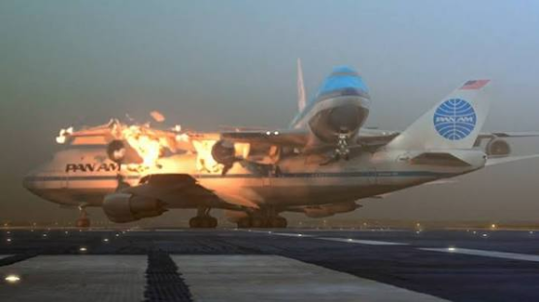
TOPIC 3
CLASSIFICATION
Aviation Accident Severity Prediction
Given the circumstances of a flight — aircraft type, engine type, weather, phase of flight — can we predict accident injury severity to help identify higher-risk conditions?
GOAL
EDA
Classify accident injury severity from structured incident data
Surface which operational/mechanical factors most strongly predict severe outcomes
DATA SOURCE
NTSB Aviation Accident Database, 1962–2023
(Kaggle)
SIZE
88,889 rows × 31 columns
APPROACH
MISSING VALUES
Substantial in several fields (Aircraft.Category ~64%, Schedule ~86%) — impute “Unknown” or drop sparse ID columns
Use only structured fields; exclude free-text narrative/remarks
Clean messy target labels (e.g. “Fatal(1)”, “Fatal(10)”) into Fatal / Serious / Minor / Incident
Random Forest classifier with class-weighting
FEATURE SPLIT
5 numerical, 26 categorical
OUTLIERS
Number of Engines has implausible values (0 or very high)
03 / 06

Slide 5

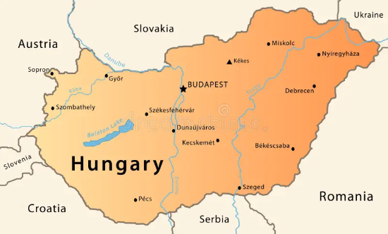
TOPIC 4
REGRESSION
Weather Temperature Prediction
Weather conditions affect everything from outdoor equipment performance to flight safety. Can air temperature be predicted from other atmospheric measurements?
GOAL
EDA
Predict temperature (°C) from humidity, wind, pressure & visibility
Quantify which atmospheric variables most strongly drive temperature
DATA SOURCE
Weather in Szeged, Hungary, 2006–2016
(Kaggle)
SIZE
96.5k rows × 12 cols → cleaned to 96,429 × 11
APPROACH
MISSING VALUES
517 nulls in Precip Type; all other columns complete
Drop constant “Loud Cover” column and duplicate rows
Exclude Apparent Temperature as a feature — it correlates 0.99 with the target and would leak the answer
Baseline Linear Regression, then Random Forest
FEATURE SPLIT
7 numerical, 4 categorical
OUTLIERS
Humidity/Pressure = 0 treated as sensor error; high wind speeds capped, not dropped
04 / 06

Slide 6
RECAP
Four Topics Summary
Topic | Type | Rows | Target
Turbofan Engine Pressure | Regression | 20,631 | HPC Outlet Static Pressure
Steam Game Popularity | Regression | 125,855 | Peak CCU (log-transformed)
Aviation Accident Severity | Classification | 88,889 | Injury Severity
Weather Temperature | Regression | 96,429 | Temperature (°C)
Special Thanks for my lead instructor, Hussain Amer and the IA’s Jubran and Fatema Alghallaf. Also, thanks for ms.Esraa Haji from our guest audience
06 / 06

